Slide 1
COLLEGE READINESS WORKSHOP WELCOME TO NEW YORK CITY!
Welcome to New York City! New York is one of the largest and most diverse cities in the world (Hong Kong is bigger!) and has people from all over the world. Thousands of people come in and out of New York every day. Maybe you have seen some of the many movies set in New York.

Slide 2
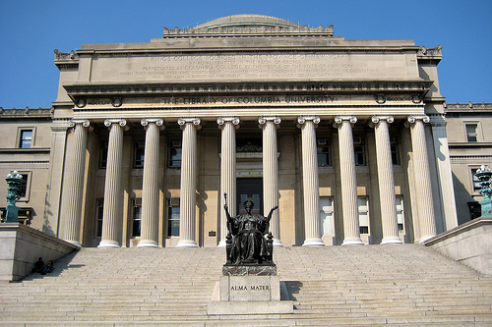
WELCOME TO COLUMBIA UNIVERSITY!
I attended both Harvard University and currently attend Columbia University where we are now. The photo below is the steps of the library at Columbia, one of the oldest universities in the United States.
Boston, another city on the east coast, has more colleges than any other city in the United States and is very near Harvard University.
Many believe the United States has the best colleges in the world.

Slide 3
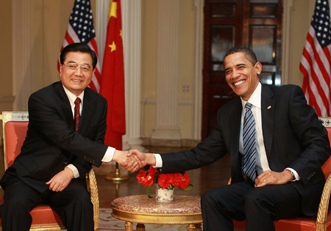
A GROWING BRIDGE BETWEEN CHINA AND THE UNITED STATES
As you know, China and the United States are becoming more and more connected. They are sharing a lot of their culture with each other.
There is even a Broadway theatre show here in New York about the crossover of the languages of Chinese and English called Ch’ing-lish! Here is a preview: http://http://www.youtube.com/watch?v=Q4jF0Tp5L98

Slide 4
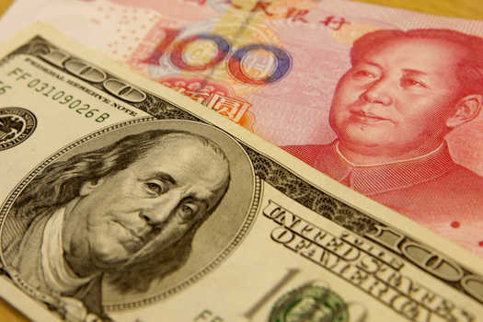
DIFFERENCES BETWEEN CHINA AND UNITED STATES
Jerry talked about differences between China and the United States. As you know it is very important to be aware of these differences as you prepare for college, especially when college will be in a country in which you did not grow up.
There are differences that are obvious like the money or food. But there are other differences such as culture, traditions, habits, and ways of relating that are more difficult to describe. Many people, for example, believe that the United States puts more focus on the individual while Chine puts more focus on the collective/group. Both are important!

Slide 5
TECHNICAL DETAILS ABOUT APPLYING FOR COLLEGE
There are of course many important aspects of planning for college in the U.S.
There is the college essay and tips on perfecting the essay.
It is important to ensure the accuracy of the application. If you make careless mistakes this will be noticed by the admissions team that looks over the applications, so be sure to spend lots of time on it and to check for errors.
Some of you will want to do a scholarship application.
You and your family need to be aware of the different categories of admission: early, accept, deferred, wait list and denied list.
You need to think about the next steps after receiving the admission decision letters.

Slide 6
TECHNICAL DETAILS ABOUT APPLYING FOR COLLEGE (Cont’d)
You need to be thinking about the steps involved in coming to the USA such as making housing arrangements (off campus, dorms, meal plans, roommates, etc).
You need to think about issues like clearing immigration: paper work (transcripts, I-20, passports, answering questions posed by the immigration officer, customs, what NOT to bring, etc.
You need to think about college life, the campus calendar, the schedule of classes, expectations in course work, research, team work, clubs and societies.
And of course making the kinds of friends you want to have is important too and that will change over time.

Slide 7
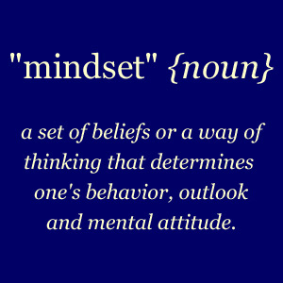
TODAY WE WILL FOCUS ON EXAMINING OUR MINDSET, BELIEFS, WAY OF THINKING AND ATTITUDE
While grades and test scores are important in applying to colleges in the United States, you will be getting other support for that and so we will not talk so much about that today.
In this workshop we will be talking more about the mindset, which is a set of beliefs or way of thinking you need to have and develop so as to improve your chances of being accepted into college in the U.S. and being successful during and after college.

Slide 8
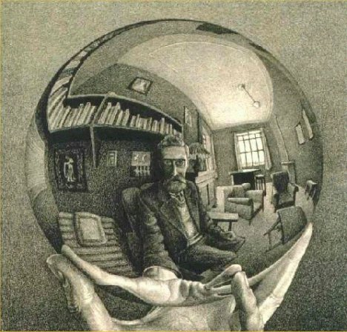
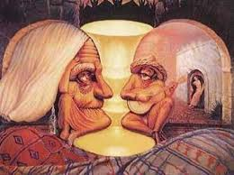
THINK ABOUT YOUR PERSPECTIVE? HOW DO YOU “LOOK” AT THINGS AND HOW DO YOU LOOK AT LIFE
As humans we have many different ways of perceiving things. We need to be aware of how we perceive, look at, and view things. These pictures are about different ways of perceiving the same picture.
What do you see when you look at them? What do you notice? Share your thoughts with the friend sitting next to you.

Slide 9
“BROADEN OUR HORIZONS” AND “OPEN OUR MINDS”
One of the most exciting things about applying to college in the United States is that coming to school here will help broaden your horizons and open your mind to new possibilities. Not only is it a different culture with a different history, but the U.S. is a place with many opportunities to think in new, creative ways. What you used to not think was possible might actually be possible!
What do you notice about this picture? Share with the friend next to you what you notice. How do you interpret it?

Slide 10
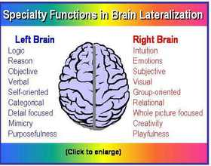
REACHING YOUR POTENTIAL
One of the main goals of today is for you to think about how you can raise your potential. Potential mean what you are capable of. Each person has a potential that is much higher than they think it is! The closer you get to reaching your full potential the better chance you have of getting into a top college of your choice.
Did you know that on average humans only use 5% of their brains? Albert Einstein only used a slightly larger % of his brain!
We have two different parts of our brain (left and right). The left side is focused on the analytical, the mathematical, reason, scientific and logic. The right side is focused on creativity, music, emotions, and holistic thinking, intuition and playfulness. Our challenge is to integrate, or bring together, both parts of our brain!
In second photo it makes it look like the left brain is boring and the right brain is more exciting and free. This is an exaggeration, and in fact we need to use both sides of our brain so as to reach our highest potential!

Slide 11
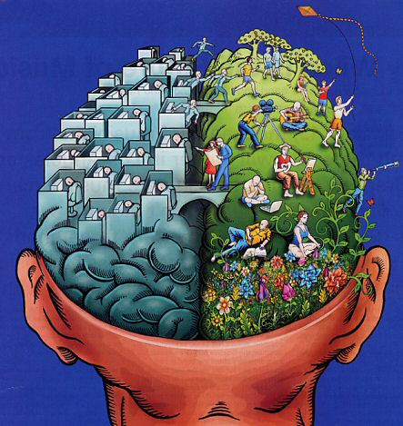
REACHING YOUR POTENTIAL (Cont’d)
Share with your partner next to you what you notice about these pictures. What does it make you think about? Do you think you use your “left brain” more, or your “right brain” more? How can you better combine them together, or build bridges between your left brain and your right?

Slide 12
WE ARE LIKE AN ICE BERG: MOST OF WHO WE ARE IS “UNDER WATER” AND THE WORLD SEES ONLY THE TOP PART!
How many of you have seen an iceberg or a photo of an iceberg drifting in the ocean? Did you know that most (about 90%) of an iceberg is hidden beneath the surface of the ocean, and only 10% of the iceberg is showing above the surface of ocean? We only can see 10% of the iceberg if we are in a boat!
In many ways we are like an iceberg. The world only sees 10% of us, and we have 90% hidden from view! How can we begin to show more of who we are so the world (family, friends, community) can see more of us?
With your friend next to you, share what this photo makes you think about! Is there anything you have dreamed about doing that you have never shared? And if you feel comfortable, what is something about you that is “below the surface?”

Slide 13
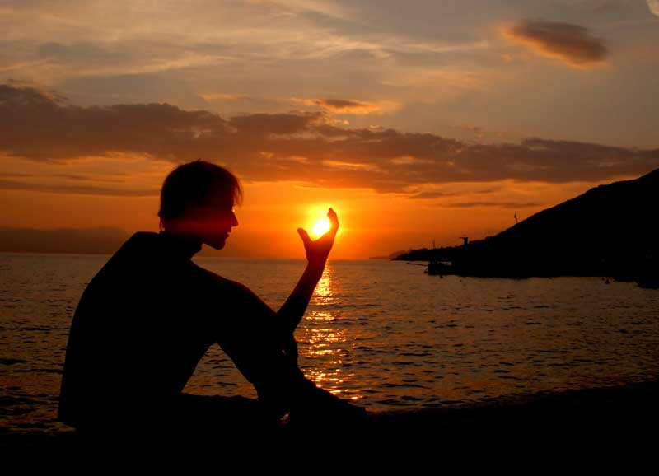
GETTING TO KNOW YOURSELF AND EACH OTHER BETTER
One of our main goals today is to get to know each other and get to know ourselves better.
The better you get to know yourself, the better you will know what you want with college, with your future career, and with your life. The better you know yourself, the better you will be able to describe in your college essay who you are, and the better chance you have of getting accepted to your choice of college!
Self-knowledge, or knowledge of the individual, is considered very important in the United States in college applications and careers.
Remember, grades and test scores are only one part or one aspect of getting into college in the United States! It is also important to know yourself and to demonstrate in your essay that you know yourself!
With your partner answer the question “Do I know myself? In what way would you like to know yourself better?”

Slide 14
SHARING MORE ABOUT MYSELF
I had such a good time at the dinner and learned something about you, especially the students at my table. I want to share a bit more about myself.
I am part Spanish (Spain), part Irish and part Norwegian. My parents met in New York but moved 3000 miles away to California where I was raised. As a child I lived in the Napa Valley just one hour from San Francisco where they grow grapes to make wine. Then we moved to Berkeley and San Francisco. My mom was a nurse and delivered babies. My dad was very interested in politics and real estate, and traveled all over the world including Asia.
Half of my school was Asian-Americans. Some of my best friends were Indian-American, Japanese-American and Chinese-American. Because my high school had many Asian students, there was an ethic of studying hard. I earned straight A’s in high school in part because I was surrounded by so many Asian students who studied hard! Asia has taught me a lot, and hopefully today I will be able to teach some things to you!
As I mentioned before, I studied Math, Economics, History, Politics and Psychology at UC Berkeley. I have taught Math, History, Psychology and Film. I was also a school counselor and the director of a high school.
I love theater, film, singing and comedy, and when I was little I wanted to be a famous singer and actor. I also wanted to be the President of the United States like Barak Obama, but it does not look like that will happen!
Something more personal about me is that when I see sad movies I sometimes cry and it makes me want to help people in need.

Slide 15
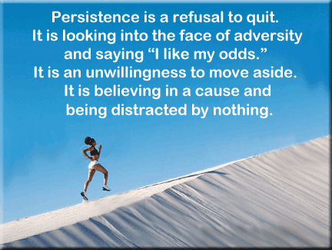
COMMITMENT, DETERMINATION AND PERSISTENCE: DON’T GIVE UP!
There are many famous quotes in United States and I’m sure in China that persistence and determination are the most important habits to have for success. Keep on trying, keep getting up when you fall, don’t give up, and you will eventually succeed!
Make a clear goal in your head of what you hope to achieve by going to college in the U.S., and understand that the United States has limitless opportunities as long as you demonstrate effort in achieving it. It takes commitment and determination!
Turn to your friend next to you and share what this picture makes you think about. Answer the following question: “In what way do you want to be more persistent, committed or determined? In what ways do you feel like you give up too easily?”

Slide 16
USE YOUR TIME WISELY IN NEXT FEW YEARS BEFORE COLLEGE
How you spend your time in the next two or three years is very important! Jerry talked about how there is still time to find out what you like and what you are good at. He talked about letters of recommendation. It is essential that you think ahead as much as you can, anticipating what you need to do.

Slide 17
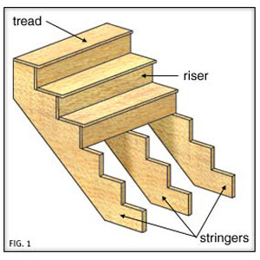
“BACKWARDS PLANNING” FOR YOUR GOALS IN YOUR LIFE
Imagine you are at the day and moment you send off your application for college, perhaps 2 or 3 years from now. Now go backwards in time to now! Imagine what deadlines would you need to meet and by which date?
A good tip (idea) is to get a calendar and mark the dates for application deadlines. With a clear understanding of what you must accomplish, you can organize yourself in a timely manner and not have to rush last-minute.
Turn to a friend and answer the question “How do you want to use your time more wisely and improve with time management? What is one area in your life that you need to plan better/more for?

Slide 18
BEING A LEADER
Jerry talked about being a leader. You can be a leader in a sport or activity, but you often have to plan for that by really committing to that activity or interest! You might need to spend one year participating so that you are strong enough or good enough to be the leader, president, or captain of that student group or sport. Just remember your timeline!
Joining extracurricular activities and being a leader will not only boost your credentials, but it is also a good opportunity to meet new people and develop your communication skills.
And if you don’t know what you like yet, try many things so you can find out what you like! This could be especially good for students who are a bit more shy. Take risks and try new things!
One way to talk about leadership is to think of heroes who were also role models and leaders. I have many heroes who were leaders, such as Martin Luther King, Gandhi, movie directors, and many others.
Turn to your friend and share with them “Who are some of your leader-heroes? Why are they a leader-hero to you? In what ways do you want to be more of a leader?”

Slide 19
A LEADERSHIP EXAMPLE FROM MY LIFE
I knew I was interested in tennis and so started playing at age 10. It took me 3-4 years of practice to be good enough to get on the tennis team. At one point I became interested in running but I realized that I loved tennis more and that I did not have time to do both tennis and running. So I set aside running and focused on tennis. I was good enough to be the top player on my high school team when I was a Junior (3rd year of high school).
I truly became a leader when I helped many of the other players to become better, and soon I was captain of the team. By the time I applied to college I had about 10 trophies from tournaments and some awards which I could share in my college application to UC Berkeley. I loved tennis so much that it helped me make friends and I made contacts who helped me in my life path for the rest of my life! So find out what you love and stick with it until you become a leader in that activity!

Slide 20
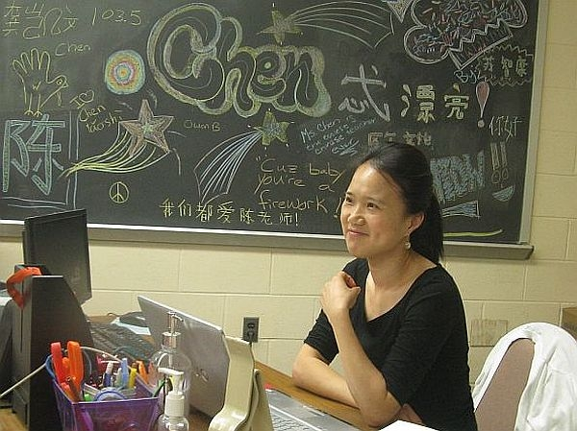
BE A LEADER IN YOUR APPROACH TOWARD RELATIONSHIPS AND ASKING FOR LETTERS OF RECOMMENDATION
A leader is usually confident in their relationships. Start to think about what teachers you want to ask for letters of recommendation.
Then the next challenge is something that can be difficult for some students. Choose teachers you think you might like and let them get to know you on a personal level. Even ask them what they think you could work on to be a better person. Share your interests and goals with them. Put in effort to get to know them, too. The better they know you, the more holisitic, honest and authentic they can be about you, and the better the letter of recommendation will be!
You want your letter to stand out, and the more honest and informed the teacher can be about you, the more it will stand out in the mind of the admissions committee. They are looking for that!
Make sure you are doing well in that teacher’s class. Try to get to know these teachers over a period of time, and try to make it a true connection. All this requires thinking in advance, planning, and “thinking backwards in time.”

Slide 21
A LEADER UNDERSTANDS THAT ALL SUBJECTS ARE INTERCONNECTED. THERE IS AN INTERDISCIPLINARY WAY OF LOOKING AT LIFE THAT WIDENS OUR PERSPECTIVE
You need to show that you have interdisciplinary knowledge and understanding (how things are interconnected to each other). For example, Math is used for Science. Language and writing is used to write good History papers. Part of History is understanding how Science played a role in history and that the arts played a role in history.
But do you understand and can you explain how Math is connected to music? Do you know how a Chinese or English sentence is similar or different from a Math sentence?
You need to keep working on your critical thinking skills, challenging the way you think about certain problems and demonstrating your ability to think more deeply about ideas and how to solve problems. Remember, problem solving is not just Math, it is in everyday life. Getting into a good college is a huge life problem that you are challenged to solve!
Turn to your friend. Can you each think of other examples of how subjects are interconnected, how they overlap, how they are connected?

Slide 22
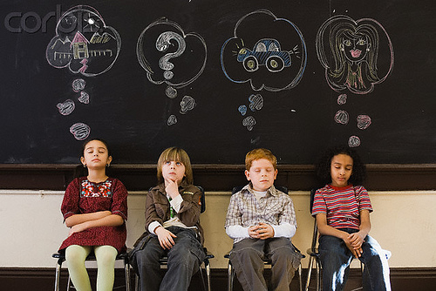
KNOWING AND UNDERSTANDING OUR INTERESTS, HOBBIES AND FAVORITE SUBJECTS AND ACTIVITIES
It is very important to think about and be able to express what your interests are. So we are going to do an exercise in which we think about what we are most interested in and what we like the most.
Here is a piece of paper with many different interests. Now you are going to make a list of 10 interests/hobbies and rank them from highest (#1) to lowest (#10). Be very honest about what the order is.
Here is my list: Dinner party with friends, Psychology, Singing, Film, Storytelling/Monologue, Travel, Fractal Patterns, Tennis, Chess, Coffee.
Make your list with your friend. Now, after you have your list, write a sentence next to it that explains why that is your interest or hobby! But don’t just say “because it is fun” or “because I like it.” Write why you like it and how you like it! For example, the reason I like singing is that it makes me feel happy, people like to hear it, and my sadness turns to happiness.

Slide 23
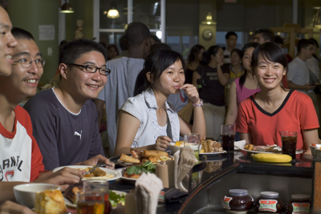
SHARING YOUR INTERESTS WITH OTHERS
Next you are going to share with three other people. First read your number one interest, then the other person will read theirs, then you read your #2, then they read their #2, and so on. If your partner has a question, they can ask you and do your best to answer them. This is meant to get practice at sharing what hobbies and interests you love with another person.
At the end, are there any questions that you want to ask of the others in your group so as to get to know them better? Try to take risks in getting to know each other. Remember, if someone asks you a question, you don’t have to answer the question if you don’t want to, but I want your group to take risks in asking questions.

Slide 24
KNOWING AND UNDERSTANDING YOURSELF
You may know what subject you like best so far, but will that change over time. You may have a favorite hobby, but that may change over time? You change, and your interests change.
Having a complete understanding of your full abilities to achieve in certain subjects is important because each subject gets more and more difficult over time. For you to succeed and truly enjoy the subject, you have to have a passion for it and truly enjoy solving math problems or reading books.
Perhaps the biggest challenge is knowing YOURSELF, how you will change over time, and thus how your interests will change over time.

Slide 25
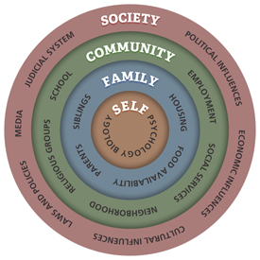
STORY OF SELF/STORY OF US: WHAT INTEREST IS “YOURS” AND WHAT INTERESTS CAME FROM YOUR FAMILY OR CULTURE? WHO ARE “YOU?”
How do you know whether it is TRULY YOU who is the reason you like that subject or hobby, or whether part of the reason you like it is because your friends like it or even a family member was good at that subject and so that is part of the reason you like it? Will that change when you go off to college?
When you think about what you want to major in in college or what career you want, how much of that is YOUR wish and is any of it influenced by your friends or family members? Will that change over time?

Slide 26
INVESTIGATE YOURSELF LIKE A DETECTIVE
Colleges want to know, and FEEL in your essay that you have thought about yourself, even investigated yourself like a detective. Think about books and movies in China in which the main character is a detective who solves mysteries. They look very deep at the mystery, look for evidence, and try to solve the mystery.
Now imagine being a detective of yourself! Do you know everything about yourself at the age of 15 or 16? No! What can you still learn about yourself?
With your partner answer the question “What do you want to find out about yourself? In what part of your life do you want to be a detective? What do you think you will find out about yourself?”

Slide 27
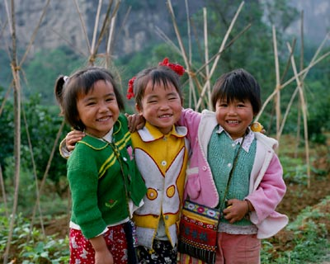
WHAT WERE YOUR SIGNIFICANT AND MOST IMPORTANT EXPERIENCES OF YOUR LIFE?
The most common question college essays will ask you is “What was a significant experience for you and why was it significant?” or “What was a significant choice you made in your life and why was it significant choice” and questions like that.
You need to practice thinking about these moments in your life and also practice being able to express them in writing and verbally!
Some students have some difficulty answering this on college essays. Some examples are “a loved one dying” or “moving to a new town or a new school” and feeling alone. Some significant experiences are the type we all go through, and some are unique to you.
With you partner share a significant experience you had in life.

Slide 28
SIGNIFICANT EXPERIENCE IN MY LIFE
Here is an example of my life. When I was 15 or 16 years old…it was not so easy to learn about myself because I thought I had to act a certain way to be accepted. I did not have a brother, my dad was gone a lot of the time, and I felt a bit lonely. I felt pressured to be a part of a group of boys who, rather than study, wanted to party and get in trouble. I wanted to be included with them. But luckily my mom talked to me and I made a decision not to be part of this group and to focus on friends who studied. I had to be honest with myself and think about who I really was and what my interests were! I had to challenge who I thought I was and what I thought I wanted. I wrote about this in my college application and I think it helped!
In another part of my application I shared that my mom struggled for some years when I was little because we were poor for several years and some people did not give her opportunities. I shared that she worked really hard in nursing school and sacrificed a lot for her kids so that we could focus on school and that I wanted to help people in some of the same ways.
I wrote very carefully, shared personal things that were sad, but also wrote intelligently about my life in my essays and it helped me get into one of the best schools in the world when I was only 17 years old: UC Berkeley!

Slide 29
WHAT IS YOUR PUZZLE PIECE?
Do you know what a puzzle is? Here is a photo.
Each piece of the puzzle fits together to make a whole of our family or our school or even our town and country. We are each like a piece of puzzle that is unique.
Can you draw your puzzle piece and put in the four main qualities of yourself? Go ahead and take a couple minutes to draw a puzzle piece and put your four main qualities on it. They could be your best academic quality, your main hobby, your dream for the world, and what it is that is most kind/caring/loving about you.

Slide 30
POLISHING YOUR GEMSTONE/JEWEL: SEE ALL THE COLORS!
Now imagine you are like a jewel, gem or a gemstone, like a diamond or sapphire or ruby (show photo). Imagine that this gem is usually bright and shining so that you can see all the colors. But sometimes that gem gets a cover of dust on it so you cannot see it shine.
Sometimes we are like that. We cannot see the shining of our own gem.
With a partner answer the following questions: “What do you think is the dust on your own jewel/gem/gemstone?” How can you dust it off or wash it off? In what way do you want to shine more?

Slide 31
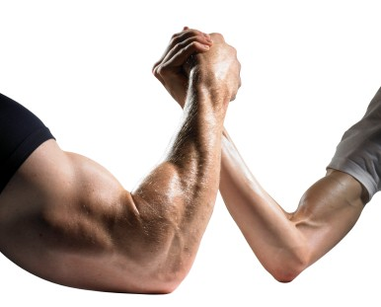
IDENTIFY A TALENT WHILE IMPROVING A WEAKNESS
Now we will work on how we would express this in a college essay. Let’s say you identify a talent that you would like to explore or develop, and also a weakness that you want to improve. Communicating this in your college essay gives it more personality and will make it stand out from all the others.
For example, let's say you are a student who is not satisfied with the way you pronounce English words, but you are interested in improving. In your essay, you can point out this weakness and also identify a role model whose pronunciation you would like to emulate (for instance, a radio or TV personality), and then explain how you plan to utilize a particular resource at your school (e.g., radio station, acting club) to improve this weakness.
Strengthening a weakness is like “removing the dust from your gemstone” and also demonstrates a humbleness and commitment to improving in this area which is important for your college essay.
Now each take 3 minutes to write down a talent you want to develop, what one of your weaknesses is, and a creative way that you will improve yourself. Now find a partner and talk about how you will take the dust off of your gem/jewel!

Slide 32
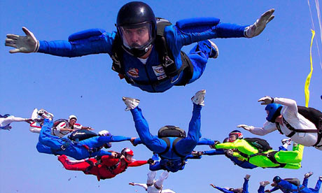
TAKING INTELLIGENT OR SMART RISKS
A big part of growing up, going to college and becoming an adult is to take on challenges and take risks. Of course we want to be safe and we should never take dangerous risks physically or psychologically. But we can take little risks. For example, many of us are afraid to share about ourselves and we can take a bigger risk in sharing.
Remember only a few people came up to share about themselves in the room). Why do you think only a few people came up to the front to share? What are we afraid of? What do we fear will happen if we take risks in expressing ourselves?
Some people think that FEAR is the thing that most stops us in life from getting what we want.
Let’s take some risks with each other. You are on this amazing trip to the United States and are learning about the culture and colleges here. Let’s have fun experimenting with letting others know more about us, taking “good risks.”
I want volunteers to come up in front of the class and they will get asked questions by everyone else. See how brave you can be!

Slide 33
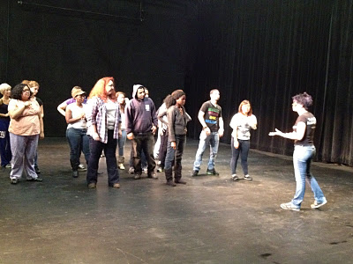
PLAYING A FUN GAME ABOUT TAKING RISKS
We all get together in a circle and take out one chair. One person comes to the center of the circle and says something about themselves, such as “I have a sibling…anyone else?” and everyone who has sibling stands up and finds a different chair! You could also say “My favorite subject is Math…anyone else?” and if Math is your favorite subject you stand up and find a new chair! If you feel comfortable sharing something more personal about yourself, you can!

Slide 34
ARETE: WHEN WE REVEAL OUR ESSENCE (THE REST OF THE ICEBERG) WE DISCOVER OUR EXCELLENCE!
One way of thinking about the iceberg example is that the “surface 10%” is what we show, but there most of us, most of our “essence” is below the surface.
In Greek (remember that the Greeks had a thriving civilization 2000 years ago when most other parts of the world were not as developed) have a word called “Arete” which “excellence” but it also means “essence,” “virtue” and “goodness.”
Many Greeks believed that when you find your essence, you will also find virtue, goodness and be excellent at what you do.
It is interesting to think about what is our deeper essence and how we can be more excellence!

Slide 35
I HOPE YOU ALL FIND YOUR ESSENCE, CREATE EXCELLENCE, GET INTO THE COLLEGE YOU CHOOSE, AND HAVE A HAPPY LIFE. THANK YOU FOR THIS WONDERFUL OPPORTUNITY, AND GOODBYE (FOR NOW!)

